Slide 1
Predicting Product Revenue
Springboard Capstone 3
Roman Quijano
May 2021

Slide 2
Predicting Revenue
The purpose of this project was to create a model to predict product revenue on a quarterly basis to best determine where the bulk of company marketing and production efforts should be focused to maximize revenue

Slide 3
Results
After working through the data science method a Random Forest model was generated that predicted Product S10_1949 as the product with the highest revenue ($15,722)
The model had an R-Squared of 0.8242 ensuring it is over the reliability standard which was set as 0.8

Slide 4
Data Wrangling
The first step was to read in and observe the data. The data didn’t contain any null values but some of the data needed to be removed and fixed.
The revenue column was initially calculated incorrectly as if price each was over 100 it was calculated at 100 instead of the higher value

Slide 5
Exploratory Analysis
Through exploratory analysis I took a look at many comparisons among the now cleaned data. However, the most telling was the correlation heatmap which you’ll see on the next slide

Slide 6
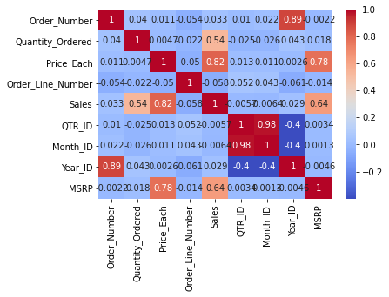
Correlation Heatmap

Slide 7
Initial Model
My initial linear regression model yielded an R-Squared of 0.6677 which is decent but not strong enough to present reliable results. However, with that starting point I was confident that other models could help get over the goal of 0.8

Slide 8

Extended Modeling
After looking through a few other options the best score was observed with a Random Forest model and after some tuning an R-Squared of 0.8242 was achieved which was the strongest I could make this model

Slide 9
Integration
After running through the data I had on quarter 2 the model identified S10_1949 as the top revenue product for Q2 2005 ($15,722)

Slide 10
Recommendations
For this quarter:
My recommendation would be to focus more marketing and production efforts into S10_1949 to maximize revenue as it is already shown to be the best product for this quarter

Slide 11
Future Recommendations
For future use:
I would recommend running more data through this model in the future to improve its performance. As more quarters of data are added the model should perform even stronger and help assess future revenue

Slide 12
Future Modeling Work
This model can certainly be improved with data such as:
Discounts
Production Costs
Profit Margins
Including these in the model can answer different questions and/or improve its ability to answer the one posed here

